Slide 1
Network Device and Configuration (ITec4113)
Chapter One: Device Configuration

Slide 2
Introduction
In this chapter, you will be introduced to the Internetwork Operating System (IOS). The IOS is what runs the Cisco routers and also Cisco switches, which allows you to configure the devices as well.

Slide 3
IOS
The IOS is a proprietary kernel that provides routing, switching, internetworking, and telecommunications features.
The first IOS was written by William Yeager in 1986 and enabled networked applications.
It runs on most Cisco routers as well as a growing number of Cisco Catalyst switches.
Some important things that the IOS software is responsible for:
Carrying network protocols and functions
Connecting high-speed traffic between devices
Adding security to control access and stop unauthorized network use
Providing scalability for ease of network growth and redundancy
Supplying network reliability for connecting to network resources
Stored in flash memory
contents in memory are not lost when the device loses power
allows the IOS to be upgraded to newer versions

Slide 4
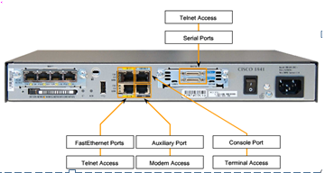
Access Methods
Console
also known as the CTY line
uses a low-speed connection to a computer or terminal
a management port that provides out-of-band access
used to access a device when the networking services have not been started or have failed
initial configuration of the device
password recovery
disaster recovery procedures and troubleshooting when remote access is not possible

Slide 5
Access Methods Cont…
Telnet or Secure Shell (SSH)
Telnet sessions require active networking services on the device
network device must have at least one active interface configured with a Layer 3 address
establish a password for virtual terminal line (VTY) connection
SSH provides stronger password authentication than Telnet and uses encryption when transporting session data
Auxiliary
establish a CLI session remotely via a telephone dialup connection using a modem connected to the AUX port
can also be used locally when there are problems using the console port

Slide 6
Configuration Files
Network devices depend on two types of software for their operation:
Operating system
Configuration files
Like the operating system in any computer, the operating system facilitates the basic operation of the device's hardware components.
Configuration files contain the IOS software commands used to customize the functionality of a device.
Types of Configuration Files
A Cisco network device contains two configuration files:
The running configuration file - used during the current operation of the device
The startup configuration file - used as the backup configuration and is loaded when the device is started

Slide 7
Configuration Files Cont…
Startup Configuration File
The startup configuration file (startup-config) is used during system startup to configure the device.
The startup configuration file or startup-config file is stored in non-volatile RAM (NVRAM). Since NVRAM is non-volatile, when the Cisco device is turned off, the file remains intact.
The startup-config files are loaded into RAM each time the device is started or reloaded. Once the configuration file is loaded into RAM, it is considered the running configuration or running-config.

Slide 8
Configuration Files Cont…
Running Configuration
Once in RAM, this configuration is used to operate the network device.
The running configuration is modified when the network administrator performs device configuration. Changes to the running configuration will immediately affect the operation of the Cisco device.
Because the running configuration file is in RAM, it is lost if the power to the device is turned off or if the device is restarted.
Changes made to the running-config file will also be lost if they are not saved to the startup-config file before the device is powered down.

Slide 9
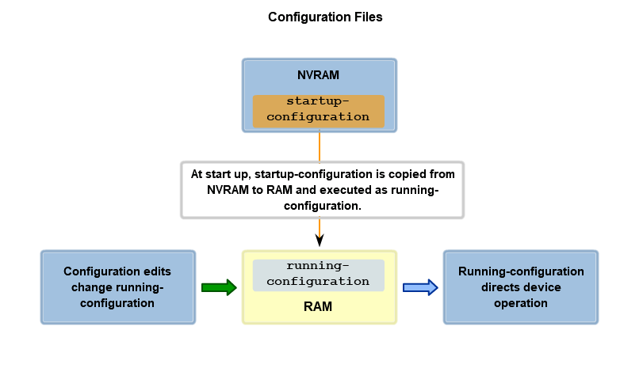
Configuration Files Cont…

Slide 10
IOS Modes
The IOS is designed as a modal operating system.
The term modal describes a system where there are different modes of operation, each having its own domain of operation.
The CLI uses a hierarchical structure for the modes.
In order from top to bottom, the major modes are:
User executive mode
Privileged executive mode
Global configuration mode
Other specific configuration mode
Each mode is used to accomplish particular tasks and has a specific set of commands that are available when in that mode.
Each mode is distinguished with a distinctive prompt, and only commands that are appropriate for that mode are allowed.

Slide 11
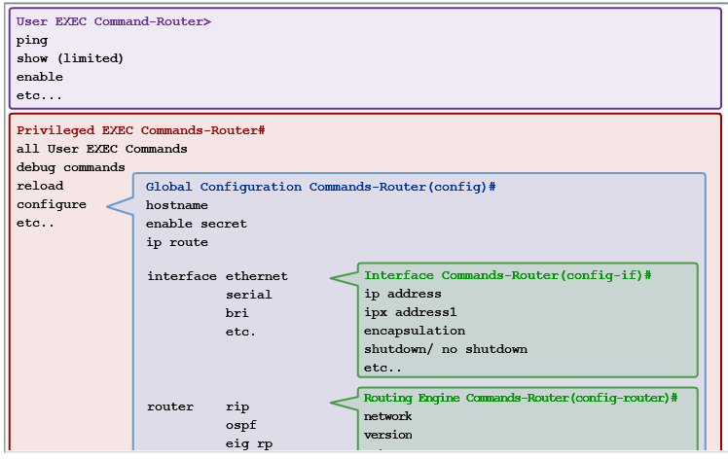
IOS Modes Cont…

Slide 12
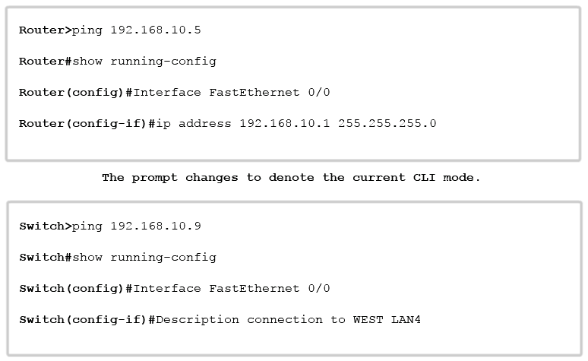
IOS Modes Cont…
Command Prompts
When using the CLI, the mode is identified by the command-line prompt that is unique to that mode. The prompt is composed of the words and symbols on the line to the left of the entry area.
The word prompt is used because the system is prompting you to make an entry.

Slide 13
IOS Modes Cont…
User Executive Mode
The user executive mode, or user EXEC for short, has limited capabilities but is useful for some basic operations.
The user EXEC mode is at the top of the modal hierarchical structure.
This mode is the first entrance into the CLI of an IOS.
The user EXEC mode allows only a limited number of basic monitoring commands. This is often referred to as view-only mode.
The user EXEC level does not allow the execution of any commands that might change the configuration of the device.
The user EXEC mode is identified by the CLI prompt that ends with the > symbol. This is an example that shows the > symbol in the prompt:
Switch>
Router>

Slide 14
IOS Modes Cont…
Privileged EXEC Mode
The execution of configuration and management commands requires that the network administrator use the privileged EXEC mode, or a specific mode further down the hierarchy.
The privileged EXEC mode can be identified by the prompt ending with the # symbol.
Switch#
Router#
Global configuration mode and all other more specific configuration modes can only be reached from the privileged EXEC mode.

Slide 15
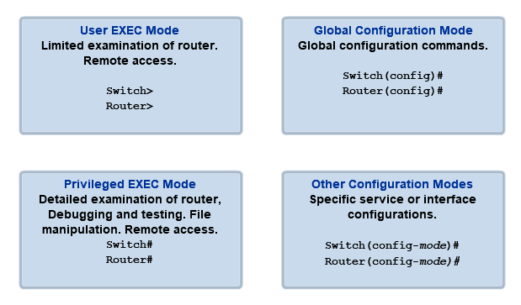
IOS Modes Cont…

Slide 16
Cisco Discovery Protocol (CDP)
Cisco Discovery Protocol (CDP) is a proprietary protocol designed by Cisco to help administrators collect information about locally attached devices.
Armed with CDP, you can gather hardware and protocol information about neighbor devices, which is crucial information to have when troubleshooting and documenting the network.
Getting CDP Timers and Holdtime Information
The show cdp command gives you information about two CDP global parameters that can be configured on Cisco devices:
CDP timer delimits how often CDP packets are transmitted out all active interfaces.
CDP holdtime delimits the amount of time that the device will hold packets received from neighbor devices.

Slide 17
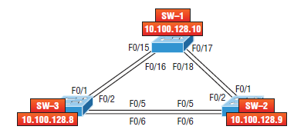
Cisco Discovery Protocol (CDP) Cont..
SW-3#show cdp
Global CDP information:
Sending CDP packets every 60 seconds
Sending a holdtime value of 180 seconds
Sending CDPv2 advertisements is enabled
This output tells us that the default transmits every 60 seconds and will hold packets from a neighbor in the CDP table for 180 seconds.

Slide 18
Cisco Discovery Protocol (CDP) Cont..
SW-3(config)#cdp holdtime ?
<10-255> Length of time (in sec) that receiver must keep this packet
SW-3(config)#cdp timer ?
<5-254> Rate at which CDP packets are sent (in sec)
You can turn off CDP completely with the no cdp run command from global configuration mode of a router/switch and enable it with the cdp run command:
SW-3(config)#no cdp run
SW-3(config)#cdp run

Slide 19
virtual LAN (VLAN)
A VLAN allows a network administrator to create groups of logically networked devices that act as if they are on their own independent network, even if they share a common infrastructure with other VLANs.
Using VLANs, you can logically segment switched networks based on functions, departments, or project teams.
VLANs allow the network administrator to implement access and security policies to particular groups of users.
A VLAN is a logically separate IP sub network. VLANs allow multiple IP networks and subnets to exist on the same switched network.
For computers to communicate on the same VLAN, each must have an IP address and a subnet mask that is consistent for that VLAN.
The switch has to be configured with the VLAN and each port in the switch must be assigned to the VLAN.

Slide 20
virtual LAN (VLAN) Cont…
A switch port with a singular VLAN configured on it is called an access port.
Remember:
Just because two computers are physically connected to the same switch does not mean that they can communicate.
Devices on two separate networks and subnets must communicate via a router (Layer 3 device), whether or not VLANs are used.

Slide 21
Benefits of a VLAN
User productivity and network adaptability are key drivers for business growth and success. Implementing VLAN technology enables a network to more flexibly support business goals.
The primary benefits of using VLANs are as follows:
Security - Groups that have sensitive data are separated from the rest of the network, decreasing the chances of confidential information breaches. Faculty computers are on VLAN 10 and completely separated from student and guest data traffic.
Cost reduction - Cost savings result from less need for expensive network upgrades and more efficient use of existing bandwidth and uplinks.
Broadcast Storm Mitigation - Dividing a network into VLANs reduces the number of devices that may participate in a broadcast storm.
Higher performance - Dividing flat Layer 2 networks into multiple logical workgroups (broadcast domains) reduces unnecessary traffic on the network and boosts performance.

Slide 22
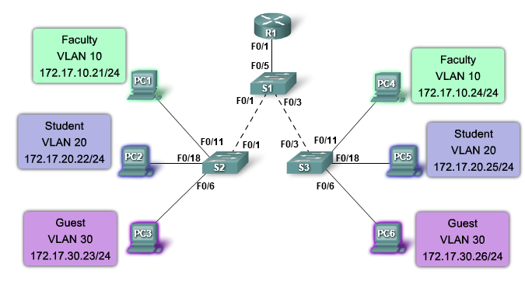
Benefits of a VLAN Cont…

Slide 23
VLAN ID Ranges
Access VLANs are divided into either a normal range or an extended range.
Normal Range VLANs
Used in small- and medium-sized business and enterprise networks.
Identified by a VLAN ID between 1 and 1005.
IDs 1 and 1002 to 1005 are automatically created and cannot be removed.
Configurations are stored within a VLAN database file, called vlan.dat. The vlan.dat file is located in the flash memory of the switch.
The VLAN trunking protocol (VTP), which helps manage VLAN configurations between switches, can only learn normal range VLANs and stores them in the VLAN database file.

Slide 24
VLAN ID Ranges Cont…
Extended Range VLANs
Enable service providers to extend their infrastructure to a greater number of customers. Some global enterprises could be large enough to need extended range VLAN IDs.
Are identified by a VLAN ID between 1006 and 4094.
Support fewer VLAN features than normal range VLANs.
Are saved in the running configuration file.
VTP does not learn extended range VLANs.

Slide 25
Types of VLAN
Today there is essentially one way of implementing VLANs - port-based VLANs. A port-based VLAN is associated with a port called an access VLAN.
However in the network there are a number of terms for VLANs. Some terms define the type of network traffic they carry and others define a specific function a VLAN performs.
The following describes common VLAN terminology:
Data VLAN
A data VLAN is a VLAN that is configured to carry only user-generated traffic. A VLAN could carry voice-based traffic or traffic used to manage the switch, but this traffic would not be part of a data VLAN.
It is common practice to separate voice and management traffic from data traffic.

Slide 26
Types of VLAN Cont…
Default VLAN
All switch ports become a member of the default VLAN after the initial boot up of the switch.
Having all the switch ports participate in the default VLAN makes them all part of the same broadcast domain. This allows any device connected to any switch port to communicate with other devices on other switch ports.
The default VLAN for Cisco switches is VLAN 1. VLAN 1 has all the features of any VLAN, except that you cannot rename it and you can not delete it.
Native VLAN
A native VLAN is assigned to an 802.1Q trunk port.
An 802.1Q trunk port supports traffic coming from many VLANs (tagged traffic) as well as traffic that does not come from a VLAN (untagged traffic).

Slide 27
Types of VLAN Cont…
Management VLAN
A management VLAN is any VLAN you configure to access the management capabilities of a switch.
VLAN 1 would serve as the management VLAN if you did not proactively define a unique VLAN to serve as the management VLAN.
You assign the management VLAN an IP address and subnet mask.
Voice VLANs
It is easy to appreciate why a separate VLAN is needed to support Voice over IP (VoIP). Imagine you are receiving an emergency call and suddenly the quality of the transmission degrades so much you cannot understand what the caller is saying. VoIP traffic requires:
Assured bandwidth to ensure voice quality
Transmission priority over other types of network traffic
Ability to be routed around congested areas on the network
Delay of less than 150 milliseconds (ms) across the network

Slide 28
Virtual Private Network(VPN)
The Internet is a worldwide, publicly accessible IP network. Because of its vast global proliferation, it has become an attractive way to interconnect remote sites.
However, the fact that it is a public infrastructure poses security risks to enterprises and their internal networks.
Fortunately, VPN technology enables organizations to create private networks over the public Internet infrastructure that maintain confidentiality and security.
Organizations use VPNs to provide a virtual WAN infrastructure that connects branch offices, home offices and business partner sites.
To remain private, the traffic is encrypted. Instead of using a dedicated Layer 2 connection, such as a leased line, a VPN uses virtual connections that are routed through the Internet.

Slide 29
Benefits of VPN
Remote sites and teleworkers can connect securely to the corporate network from almost any place.
Data on a VPN is encrypted and undecipherable to anyone not entitled to have it.
VPNs bring remote hosts inside the firewall, giving them close to the same levels of access to network devices as if they were in a corporate office.
Consider these benefits when using VPNs:
Cost savings - Organizations can use cost-effective, third-party Internet transport to connect remote offices and users to the main corporate site. This eliminates expensive dedicated WAN links and modem banks. By using broadband, VPNs reduce connectivity costs while increasing remote connection bandwidth.
Security - Advanced encryption and authentication protocols protect data from unauthorized access.
Scalability - VPNs use the Internet infrastructure within ISP, making it easy for organizations to add new users. Organizations, big and small, are able to add large amounts of capacity without adding significant infrastructure.

Slide 30
Types of VPN
Site-to-site VPNs
Organizations use site-to-site VPNs to connect dispersed locations in the same way as a leased line or Frame Relay connection is used.
Because most organizations now have Internet access, it makes sense to take advantage of the benefits of site-to-site VPNs.
In effect, a site-to-site VPN is an extension of classic WAN networking.
Site-to-site VPNs connect entire networks to each other.
For example, they can connect a branch office network to a company headquarters network.
In a site-to-site VPN, hosts send and receive TCP/IP traffic through a VPN gateway, which could be a router, PIX firewall appliance, or an Adaptive Security Appliance (ASA).

Slide 31
Types of VPN Cont…
Remote access VPNs
Mobile users and telecommuters use remote access VPNs extensively.
In the past, corporations supported remote users using dialup networks. This usually involved a toll call and incurring long distance charges to access the corporation.
In a remote-access VPN, each host typically has VPN client software.
Whenever the host tries to send any traffic, the VPN client software encapsulates and encrypts that traffic before sending it over the Internet to the VPN gateway at the edge of the target network.

Slide 32
Characteristics of VPN
VPNs use advanced encryption techniques and tunneling to permit organizations to establish secure, end-to-end, private network connections over the Internet.
The foundation of a secure VPN is data confidentiality, data integrity, and authentication:
Data confidentiality - A common security concern is protecting data from eavesdroppers. As a design feature, data confidentiality aims at protecting the contents of messages from interception by unauthenticated or unauthorized sources.
Data integrity - guarantees that no tampering or alterations occur to data while it travels between the source and destination.
Authentication - Authentication ensures that a message comes from an authentic source and goes to an authentic destination.

Slide 33
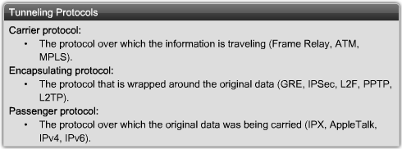
VPN Tunneling
Incorporating appropriate data confidentiality capabilities into a VPN ensures that only the intended sources and destinations are capable of interpreting the original message contents.
Tunneling allows the use of public networks like the Internet to carry data for users as if the users had access to a private network.
Tunneling encapsulates an entire packet within another packet and sends the new, composite packet over a network.

Slide 34
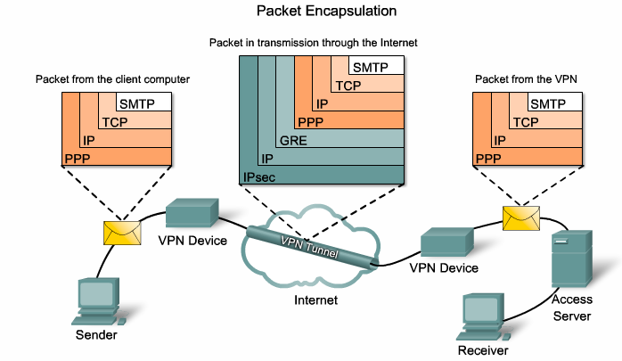
VPN Tunneling Cont..

